Slide 1
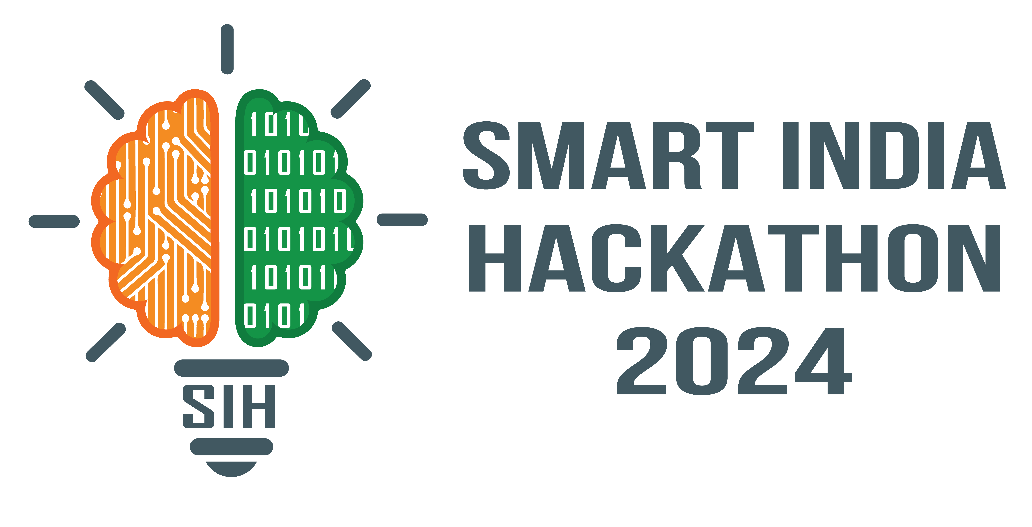
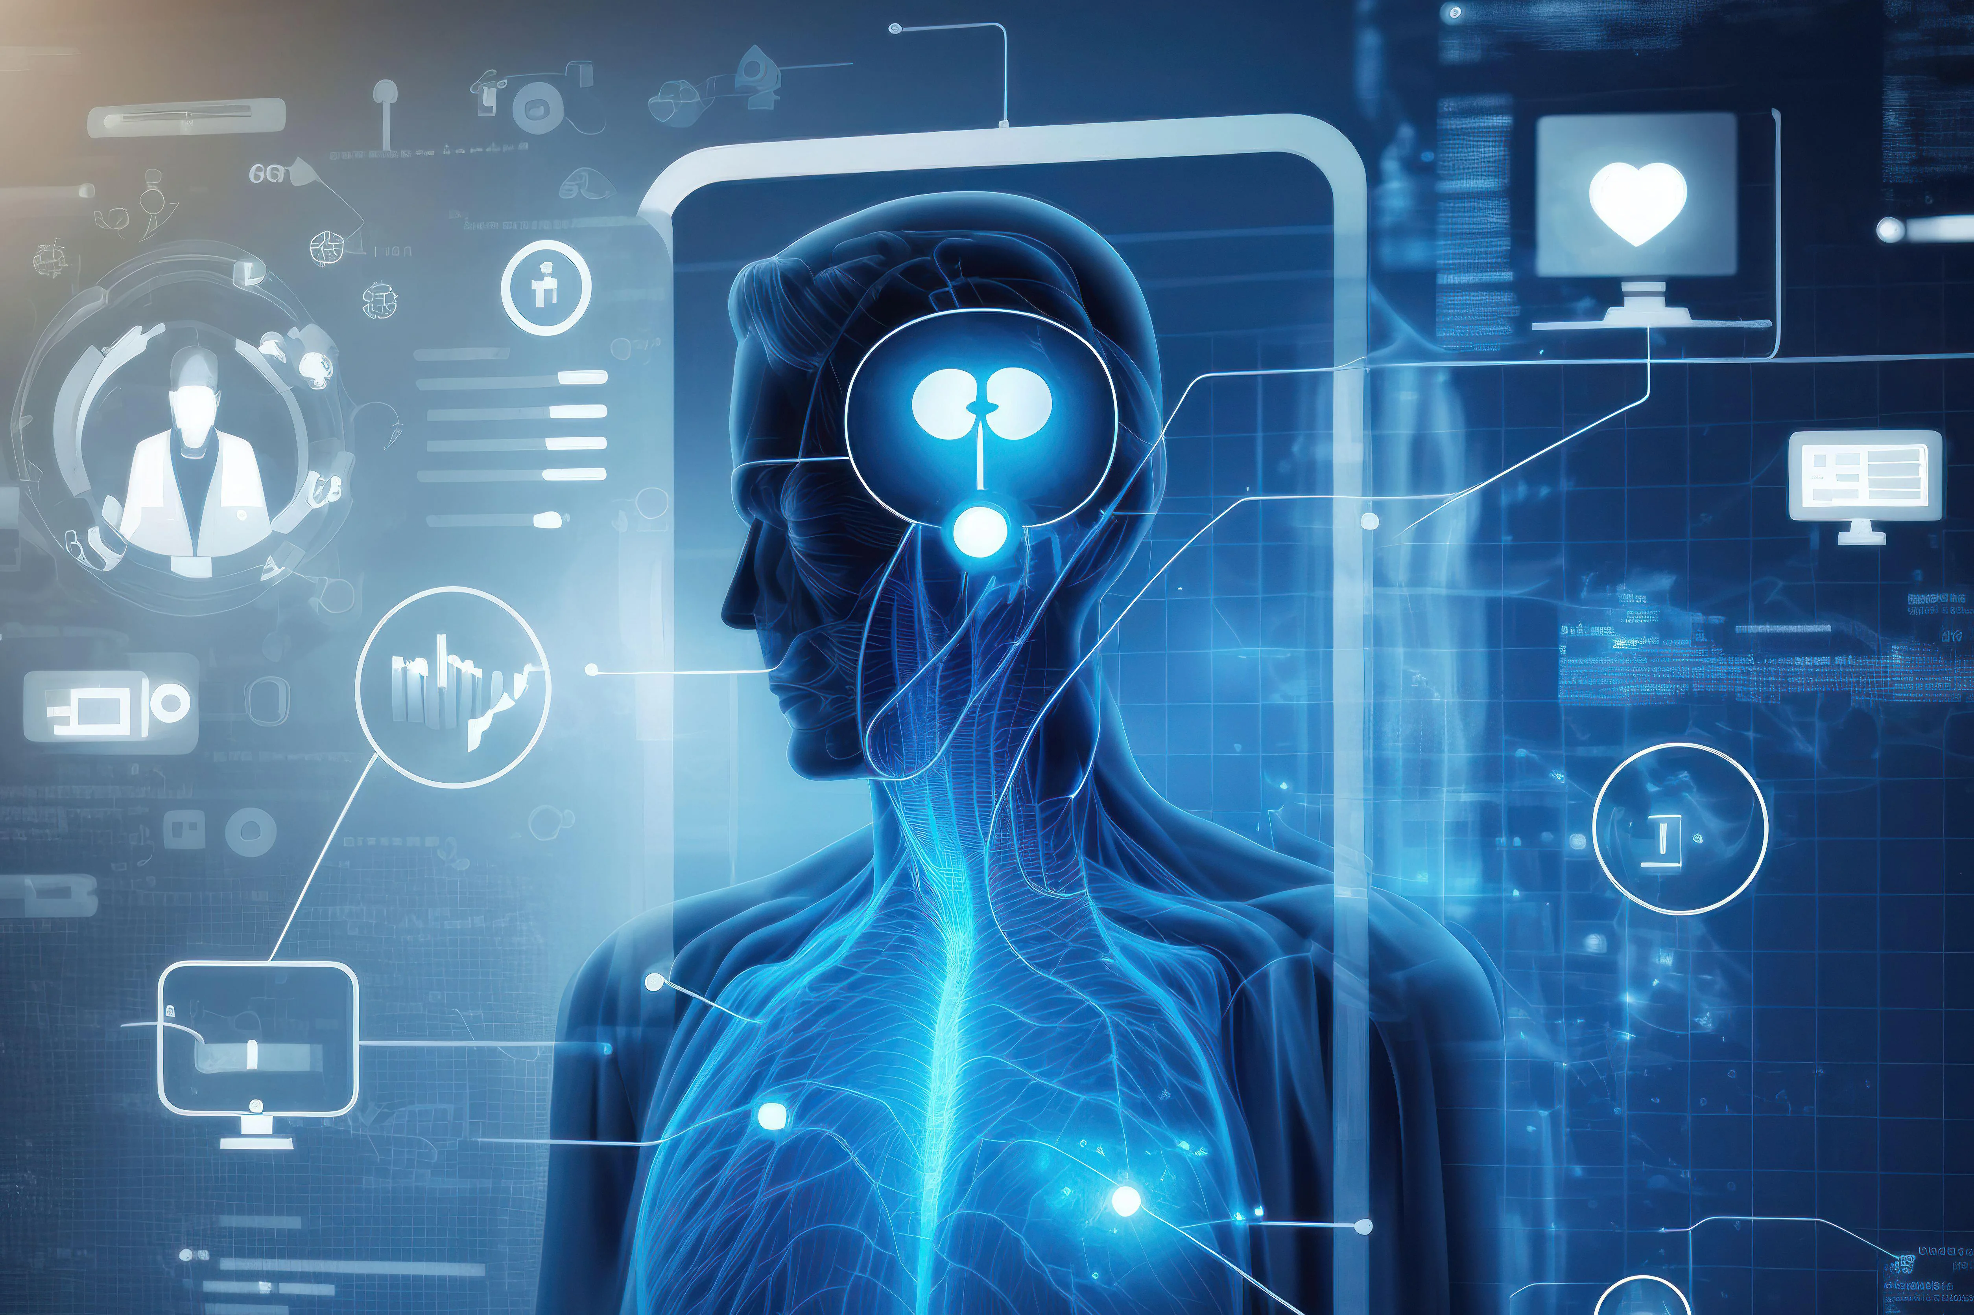

SMART INDIA HACKATHON 2024
PROBLEM STATEMENT TITLE
AI-Enhanced Healthcare Diagnostics and Management System inspired by ZK Medical Billing Platform
PROBLEM OBJECTIVE
Create an advanced healthcare diagnostics and management system using AI/ML technologies, inspired by ZK Medical Billing Platform platform:https://github.com/seetadev/ZKMedical-Billing/issues/1. The goal is to enhance medical diagnostics, patient management, and treatment planning through intelligent data analysis and automation.
PS CATEGORY : software
TEAM NAME : SHIELD

Slide 2
AI-ENHANCED HEALTHCARE DIAGNOSTICS AND MANAGEMENT SYSTEM
SHIELD
IDEA/ SOLUTION
OBJECTIVE:
Enhance diagnostics and patient management using AI/ML technologies.
USER INTERFACE:
Users upload medical images (like X-Ray) for AI analysis (FUTURE FEATURE) , receive diagnostic insights, input health data, and get personalized lifestyle tips.
LOCAL ADMIN INTERFACE:
Search for user information and vitals and manage alerts for critical conditions.
ADMIN WEB DASHBOARD:
Search patients by symptoms, use NLP to query data, and visualize health data with real-time analytics.
AI/ML INTEGRATION:
Utilize OCR for text extraction, AI models for diagnostics, and NLP for symptom-based queries.
USER EXPERIENCE:
Offer an intuitive interface with personalized recommendations.

Slide 3
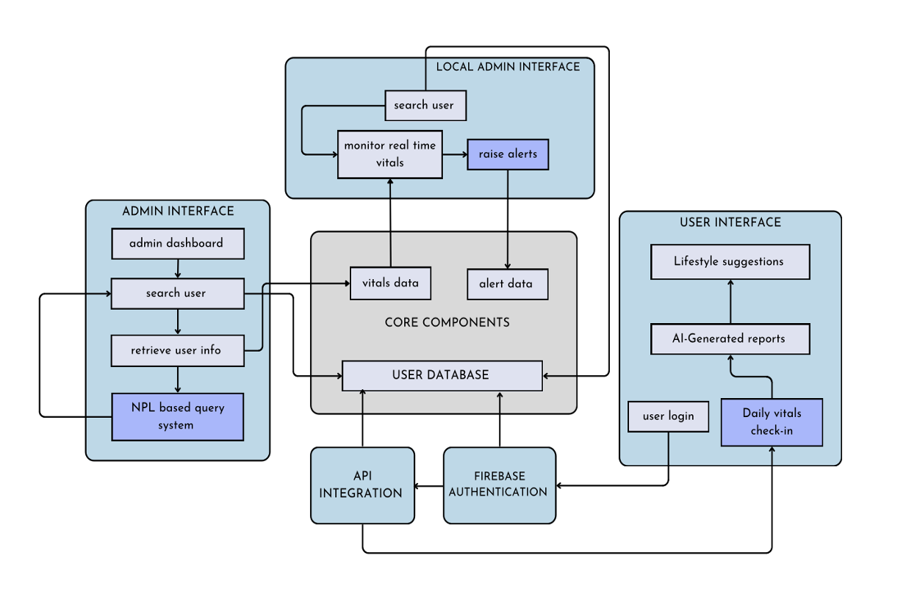
AI-ENHANCED HEALTHCARE DIAGNOSTICS AND MANAGEMENT SYSTEM
SHIELD
WORKFLOW ARCHITECTURE

Slide 4
AI-ENHANCED HEALTHCARE DIAGNOSTICS AND MANAGEMENT SYSTEM
SHIELD
PROBLEM RESOLUTION
EFFICIENT MANAGEMENT
Local Admin Alerts:
Monitor Vitals: Local admins can continuously track patient vital signs through the system.
Raise Alerts: Automatically or manually generate alerts for any vitals that fall outside safe ranges, enabling timely intervention and monitoring by healthcare providers.
Web Dashboard:
Advanced Search: Administrators can perform complex searches to locate patient records based on various criteria such as symptoms, conditions, or recent health data.
ACCURATE DIAGNOSTICS
AI/ML Models:
Analyse Medical Images: Use advanced AI algorithms to interpret medical images (e.g., X-rays) and extract relevant diagnostic information.(FUTURE FEATURE)
Patient Data Analysis: Integrate various data points (e.g., vitals, historical health records) to provide precise diagnostics and tailored treatment recommendations based on comprehensive data analysis.
Feedback Loop:
Accuracy Assurance: Collect user feedback to continuously improve AI models and ensure that recommendations align with real-world outcomes and user satisfaction.

Slide 5
AI-ENHANCED HEALTHCARE DIAGNOSTICS AND MANAGEMENT SYSTEM
SHIELD
UNIQUE VALUE PROPOSITIONS (UVP)
THREE INTERFACES:
User Interface: Allows patients to upload reports, receive AI diagnostics, and get personalized advice.
Local Admin Interface: Enables local admins to monitor vitals, search user data, and manage alerts.
Admin Web Dashboard: Provides advanced search capabilities, real-time data analytics, and NLP integration for comprehensive patient
management.
ADVANCED SEARCH AND NLP:
Symptom-Based Search: Admins use NLP to find patients with similar conditions quickly.
REAL-TIME MONITORING:
Alerts and Notifications: Local admins can act promptly on critical conditions.
COMPREHENSIVE DATA ANALYTICS
Visual Analytics: Real-time and historical data visualizations for informed decision-making.
INTEGRATED WEB AND APP FEATURES:
Seamless Integration: Web dashboard and app interface work together to provide a cohesive user experience.
Real-Time Updates: Both platforms offer up-to-date information and alerts, ensuring timely access to critical data and recommendations.

Slide 6
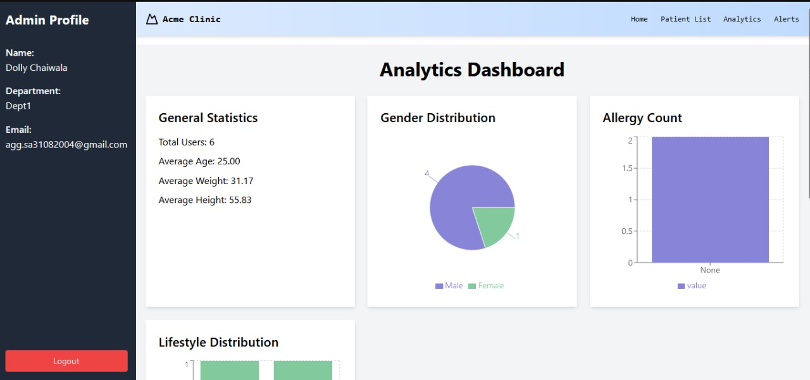
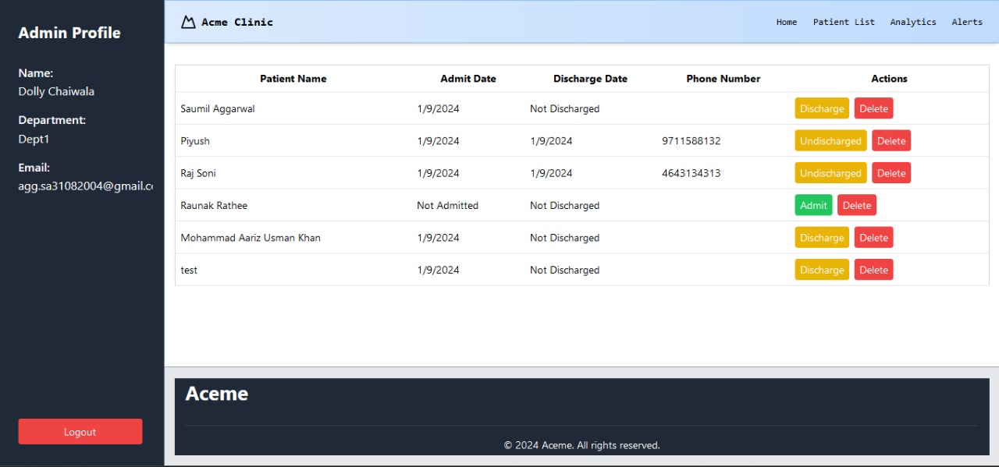
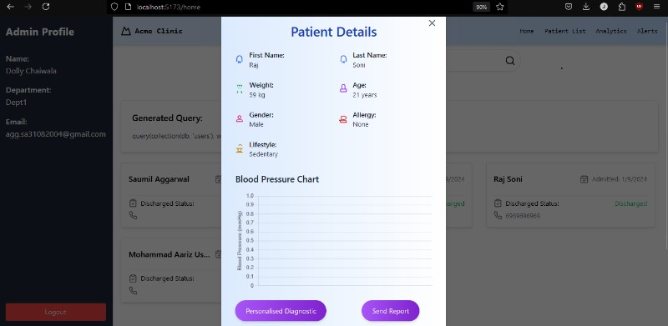
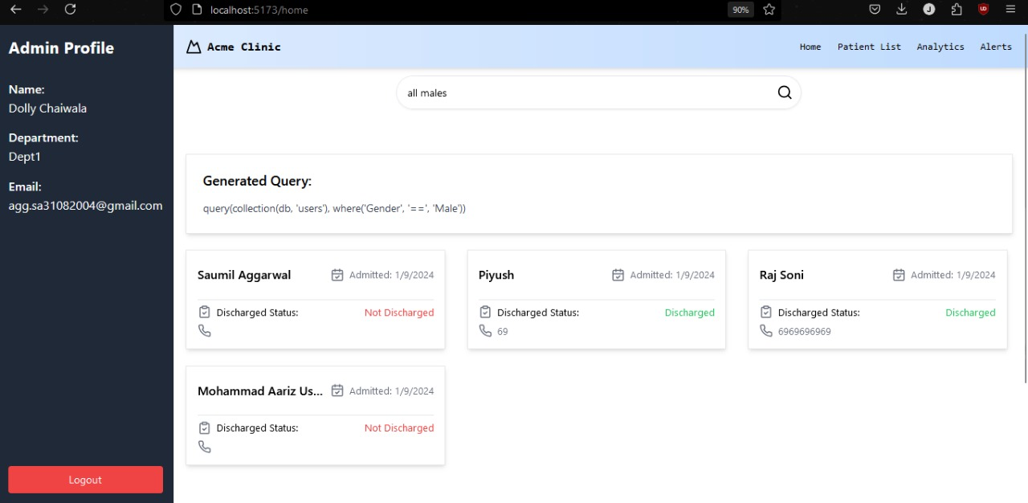
AI-ENHANCED HEALTHCARE DIAGNOSTICS AND MANAGEMENT SYSTEM
SHIELD
TECH STACK
BACKEND :
Python flask
Nodejs
FRONTEND :
React (Web App)
React native (Android Application)
DATABASE :
Google firebase
ENCRYPTION AND SECURITY :
Google firebase
AI/ML MODEL :
Gemini 1.5 flash
Random forest
XG Boost
Deep learning
CLOUD SERVICES :
Google firebase
PRODUCT STATUS : X-Ray analysis via image uploading will be available in the next update .

Slide 7
FEASIBILITY AND VIABILITY
AI-ENHANCED HEALTHCARE DIAGNOSTICS AND MANAGEMENT SYSTEM
SHIELD
ANALYSIS OF THE FEASIBILITY OF THE IDEA
Technical Feasibility:
Patient Management System (PMS)The system will leverage the existing ZK Medical Billing Platform's data management capabilities and expand them to include a comprehensive Patient Management System (PMS). This PMS will handle patient records, appointment scheduling, billing, follow-up reminders, and communication.
AI/ML Models: Existing technologies for OCR, NLP, and predictive analytics are mature and available.
Infrastructure: Cloud-based solutions can handle data storage and processing needs.
Market Feasibility:
Demand: Growing interest in digital health solutions and personalized medicine.
Competitors: Unique combination of real-time monitoring and AI diagnostics differentiates from existing solutions.
Target Audience: In addition to hospitals, clinics, and diagnostic centres, the enhanced patient management capabilities and AI-powered query system will appeal to smaller healthcare providers and private practices seeking to automate their operations.

Slide 8
IMPACT AND BENEFITS
AI-ENHANCED HEALTHCARE DIAGNOSTICS AND MANAGEMENT SYSTEM
SHIELD
PATIENTS:
Enhanced Diagnostics: Get timely and accurate insights through AI analysis for faster diagnosis and treatment.
Personalized Advice: Receive tailored health and lifestyle recommendations based on your vitals.
LOCAL ADMINS:
Efficient Monitoring: Identify and address unsafe conditions with real-time vitals and alerts.
Streamlined Management: Easily access and manage patient data with intuitive tools.
ACTUAL ADMINS:
Advanced Management: Use advanced search and NLP to find and manage patients by symptoms and conditions.
Informed Decisions: Utilize real-time data analytics for better decision-making.
EFFICIENT HEALTHCARE MANAGEMENT:
Real-Time Alerts: Act promptly on critical conditions to ensure patient safety.
Comprehensive Data Access: Seamlessly search and analyze patient data for better coordination.
DATA-DRIVEN DECISION MAKING:
Real-Time Analytics: Access up-to-date information for informed decisions and efficient resource use.
SCALABILITY AND INTEGRATION:
Seamless Integration: Ensure a consistent user experience and effective data management across web and app platforms.

Slide 9
GEOLOCATION-BASED ATTENDANCE TRACKING MOBILE APPLICATION
AI-ENHANCED HEALTHCARE DIAGNOSTICS AND MANAGEMENT SYSTEM
SHIELD
REVENUE MODEL
Subscription-Based Pricing Model
The primary revenue stream will come from a tiered subscription-based pricing model targeting healthcare providers such as hospitals, clinics, diagnostic labs, and telemedicine platforms. The subscription tiers will provide flexibility based on the size of the healthcare provider, the volume of diagnostic tests, and the range of AI features utilized.
Pay-Per-Use Pricing Model
Introduce a Pay-Per-Use Model for healthcare providers who may not need a full subscription but still want access to specific AI-driven diagnostic tools and features. This model is ideal for smaller providers or those with fluctuating patient volumes.
Data Monetization
Offer anonymized and aggregated healthcare data for Research, Pharmaceutical Companies, and Public Health Agencies to help them conduct studies, develop new drugs, or understand healthcare trends.
Marketplace for AI Tools and Modules
Create a Marketplace for AI Tools and Modules where third-party developers, healthcare providers, and other stakeholders can sell or buy AI tools, modules, and plugins to enhance their diagnostics and management systems.
.

Slide 10
GEOLOCATION-BASED ATTENDANCE TRACKING MOBILE APPLICATION
AI-ENHANCED HEALTHCARE DIAGNOSTICS AND MANAGEMENT SYSTEM
SHIELD
RESEARCH AND REFERENCES
https://firebase.google.com/docs
https://archive.ics.uci.edu/dataset/102/thyroid+disease
https://bmcbioinformatics.biomedcentral.com/articles/10.1186/s12859-022-04602-4

